Slide 1
CHAPTER 2
(INTRO TO FLUTTER)
Prepared by Nurul Amera

Slide 2
INSTALLING FLUTTER
Flutter is easy to install.
Visit: https://flutter.dev/docs/get-started/install
Download:
Flutter SDK
Dart SDK (included)
Dart command-line tool (included) No need to download Dart separately.

Slide 3
INSTALLATION GUIDE
The Flutter documentation is:
Very detailed
Explains all steps clearly
Includes possible issues and how to fix them
Important: Follow all steps completely to prepare your system for Flutter development.

Slide 4
UPDATING YOUR PATH
Add Flutter’s bin folder to your system PATH:
This lets you run flutter commands from the command line.
This step is essential to interact with Flutter and Dart through the terminal.
The Flutter website provides a guide to update your PATH variable

Slide 5
CHECKING SETUP – flutter doctor
After installation and PATH setup, run this commane (command prompt)
C:\src\flutter>flutter doctor
This will:
Check Flutter SDK
If You See Errors...
Don’t panic!
Tips to troubleshoot:
Detect Android/iOS toolchains
Detect installed IDEs (VS Code, Android Studio, etc.)
Check connected devices
Double-check your PATH
Make sure it includes flutter/bin
Restart your terminal after updating PATH

Slide 6

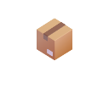


CREATING A NEW PROJECT
To start a new project, use:
flutter create <output_directory>
<output_directory> = your project name
A complete sample app will be generated Example: flutter create
Dart package names:
Use only lowercase letters and underscores
Can include numbers, but not at the startMust not use reserved words
Examples:
hello_flutter, my_app1 1stApp, new

Slide 7

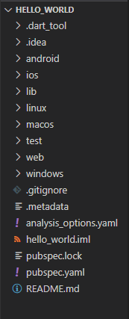
PROJECT FOLDER STRUCTURE
android/ and ios/: Contain platform-specific code. If you're familiar with Android Studio or Xcode, this structure should look familiar.
hello_flutter.iml: This is an IntelliJ project file that includes module information
(JAVA_MODULE) used by the IDE.
lib/: The core directory of your Flutter app. It contains the main Dart file (main.dart) where your app logic begins. We will explore this file in more detail later.
pubspec.yaml and pubspec.lock: These files manage the app's configuration.
pubspec.yaml defines the app name, version, dependencies (e.g., plugins, fonts, images), and
more.
pubspec.lock ensures consistency across package versions.
README.md: A markdown file used to document your project. It provides setup instructions and important notes so that other developers can easily understand and use your code.
test/: Contains all test-related files. You can write unit tests and widget tests here to help ensure your app runs as expected and to catch bugs early during development.

Slide 8
WIDGETS
In Flutter, everything is a widget.
Widgets represent UI elements and behaviors.
Widgets provide:
Modularity
Scalability
Expressiveness
Composability & Immutability

Slide 9
FLUTTER RENDERING
Flutter handles visual rendering in a unique way.
It communicates directly with the platform's SDK (camera, location, etc.).
Mobile App
Platform SDK
Services (Camera, Location)
Canvas Rendering, Input Handling

Slide 10
RENDERING BY FLUTTER ITSELF
Flutter takes full control of rendering (no reliance on native UI elements).
Only uses the platform SDK for:
Services APIs (e.g., Bluetooth, GPS)
Canvas to draw UI
User input handling
It does:
Widgets rendering
Events & gestures
Communicates via “Bridge Channels” to use platform features

Slide 11
COMPOSABILITY
Composition over inheritance
Flutter uses composition to build UI — combining smaller widgets.
Easier to manage and extend than inheritance.
Example:
A Car is made of an Engine, Wheels, Seats = Composition
Instead of inheriting everything from a Vehicle = Inheritance
Result:
More flexibility
Runtime modifications
Dependency injection-friendly

Slide 12
EVERYTHING IS A WIDGET
In Flutter, nearly everything is a widget – not just visible elements. Types of widgets:
Visual/Structural: Button, Text
Layout-specific: Padding, Row, Column
Styling: Theme
Interaction: GestureDetector, InkWell
Even the app itself is a widget!

Slide 13
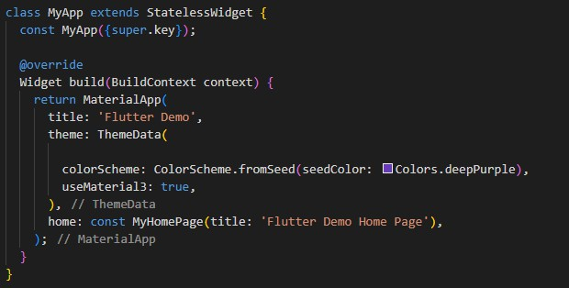
FIRST WIDGET CODE EXAMPLE
Here’s a basic example of a Flutter widget from lib/main.dart:
This example introduces:
StatelessWidget: doesn’t hold
stateMaterialApp: root of the app
build() method: returns UI

Slide 14
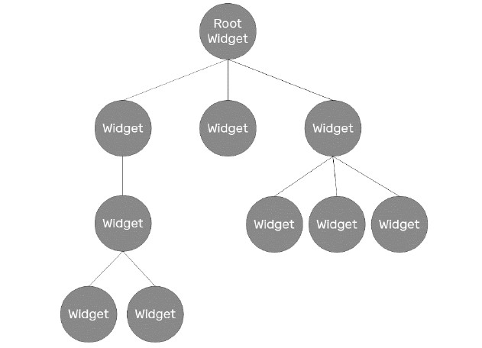
THE WIDGET TREE

Slide 15
THE WIDGET TREE
The Widget Tree is a core part of Flutter’s layout system:
It is a logical structure of all the widgets in your UI.
It is dynamically built and changes based on the widget’s child structure.
The Widget Tree is built and used during:
Layout – determining measurements and positions
Rendering – drawing widgets on screen
Hit testing – detecting user touch interactions
Flutter optimizes rendering by updating only the parts of the tree that changed.

Slide 16
WIDGET TREE NODES
Each widget in the tree is a node.
Nodes can have children, which form branches of the tree.
Every widget has the potential to be recreated when its state changes.
Flutter’s widget system:
Is compositional, not fixed
Exposes child or children properties for nesting
This dynamic structure lets Flutter be highly flexible and UI-rich.

Slide 17
MaterialApp
Scaffold
Column
Text (“Welcome”)
ElevatedButton
Text(“Click Me”)

Slide 18
WIDGET TREE + ELEMENT TREE
The Widget Tree doesn't work alone.
It works together with the Element Tree, which:
Maps widgets to their corresponding elements
Helps update or rebuild widgets when state/data changes
Maintains the widget’s position and type on screen
https://docs.flutter.dev/ui/widgets

Slide 19
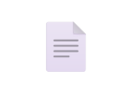
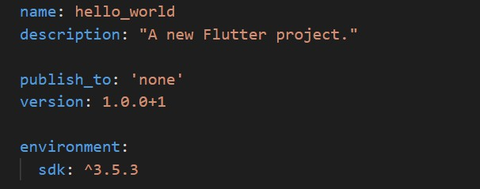
pubspec.yaml
The pubspec.yaml file:
Defines a Flutter project’s metadata, dependencies, and configuration
Is required in every Flutter project
name: Defined when using flutter create
description: Can be updated with --description flag
version: Follows Dart package versioning (major.minor.patch+build)

Slide 20
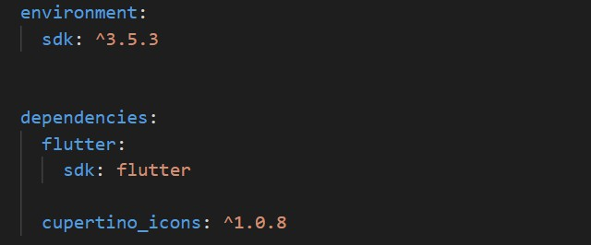
pubspec.yaml
environment: Specifies Dart SDK range supported
dependencies:
Main: Flutter SDK
Extras: Like cupertino_icons (icon sets for iOS-style UI)

Slide 21
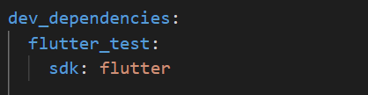
pubspec.yaml
dev_dependencies: Used only during development/testing
flutter_test: Comes with Flutter SDK, adds testing utilities

Slide 22
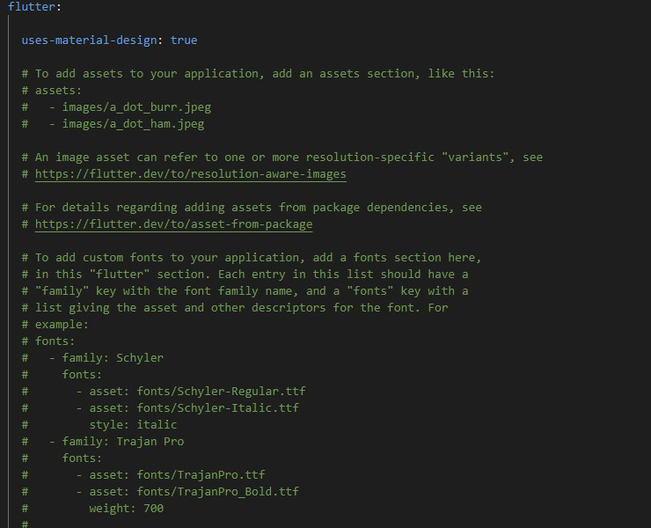
pubspec.yaml
This section allows configuration of
resources like:
Material icons
Assets (images, sound, etc.)
Fonts

Slide 23


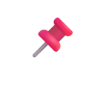


pubspec.yaml
Example: Adding a single image
Example: Including a full folder
Ending with / includes all files in that folder, but not subfolders.
To include subfolders:
https://docs.flutter.dev/ui/assets/assets-and-images

Slide 24
CHAPTER 2
(WIDGETS – BUILDING LAYOUTS IN FLUTTER)
Prepared by Nurul Amera

Slide 25
STATEFUL VS STATELESS WIDGETS
In Flutter, there are two main widget types:
Stateless Widgets: Immutable and do not hold state
Stateful Widgets: Hold state and can rebuild when state changes
Why?
UI elements are not static, they often change over time (like a counter or user interaction). Flutter
separates widgets based on whether they manage such changes.

Slide 26
STATELESS VS STATEFUL – WHEN TO USE WHICH?
Stateless: No internal state, fixed output
Stateful: Holds mutable state and adapts over time
Developer tips:
Use stateless by default unless the widget needs to change dynamically
Overusing stateful widgets can lead to performance and maintainability issues

Slide 27
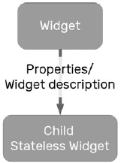

STATELESS WIDGETS
Parent widget builds a child StatelessWidget
Passes properties or descriptions
The child cannot change itself, it only receives and uses those inputs
The child widget is fully dependent on the parent’s input at creation.

Slide 28
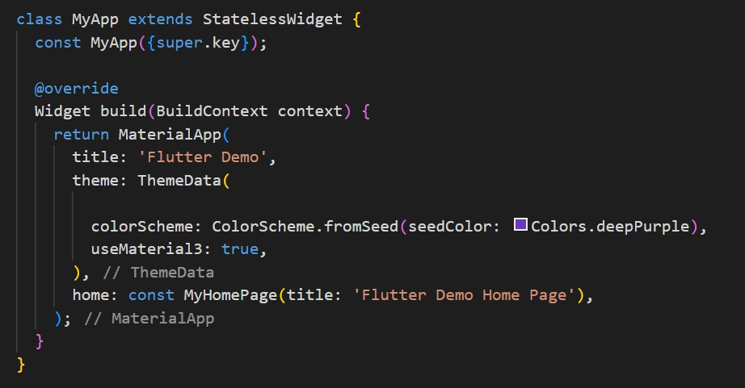
STATELESS WIDGETS

Slide 29
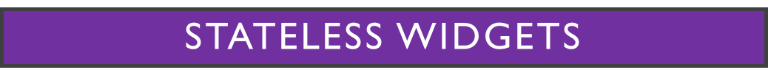
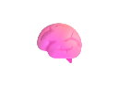
1. MyApp extends StatelessWidget
build() returns MaterialApp
No state is held — UI is built from fixed values
What is MaterialApp?
MaterialApp is a convenience widget:
“A widget that wraps a number of widgets that are
commonly required for Material Design applications.”
Role of BuildContext:
Gives access to the widget tree structure
Allows child widgets to inherit theme, styles, etc.
Helps Flutter know where this widget sits in the
tree
Used to:
Set app title
Apply global theme
Define navigation structure
Set home widget

Slide 30
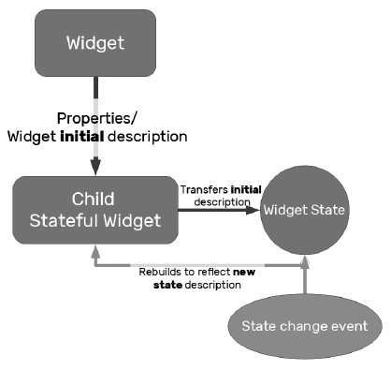
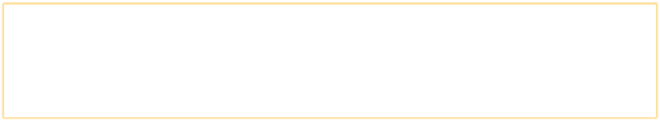
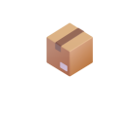
STATEFUL WIDGETS
Unlike stateless widgets, stateful widgets can change during their lifetime.
They still receive immutable properties from parents.
But they manage their own state using a companion State class.
When the state changes → Flutter rebuilds the widget tree (UI refresh).

Slide 31
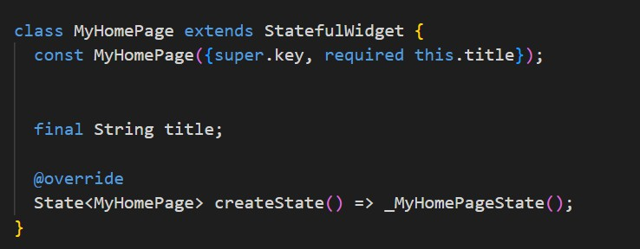
ANATOMY OF A STATEFUL WIDGET
MyHomePage extends StatefulWidget
Must override createState() to link to its State class
title is a final property passed from the parent widget

Slide 32
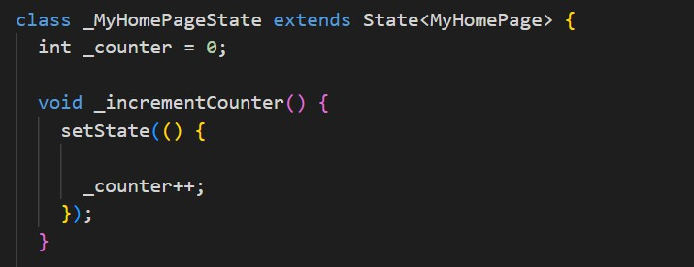

The state class for MyHomePage
Why Flutter Needs setState():
A stateful widget must update its UI based on changes over time (e.g., a counter increasing).
How does Flutter know something changed?
Notifies the framework that something has changed
Rebuilds the widget with the new state value
Does not affect unrelated widgets, only redraws what’s necessary
Holds state variable _counter
setState() updates _counter and triggers UI rebuild
State<MyHomePage> links this to MyHomePage widget

Slide 33
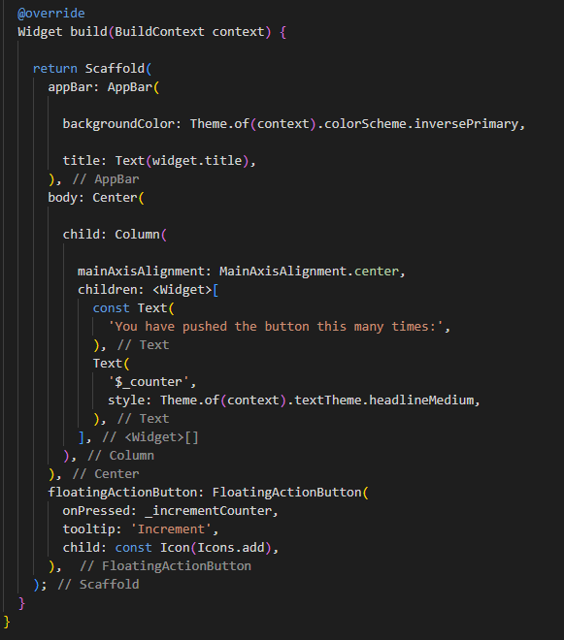
Building the UI with State

Slide 34
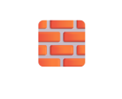
Breakdown of Scaffold Widgets
The build() method for stateful widgets:
Has the same structure as stateless widgets
But can access and react to state
In our counter app: We use Scaffold, which holds 3 key widgets:
appBar:
Displays the title
Uses the value passed from MyHomePage (widget.title)
body:
Centered layout using Center and Column
Holds two Text widgets — one fixed and one showing $_counter
floatingActionButton:
Positioned at the bottom right
Triggers _incrementCounter() on press

Slide 35
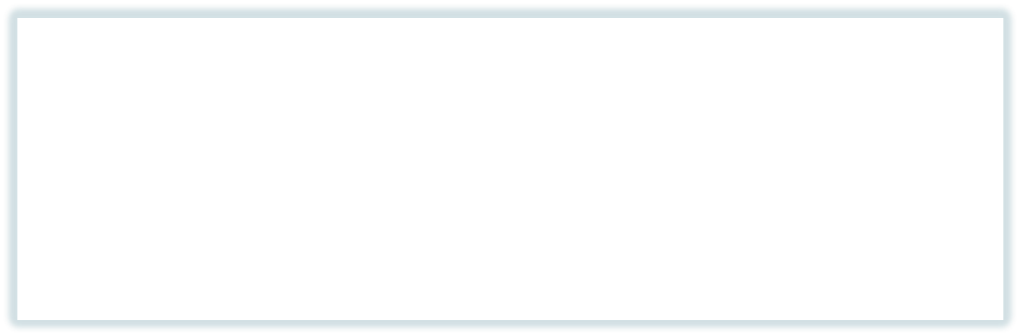
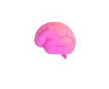
The Full State Update Flow
What happens when you press the "+" button::
MyHomePage builds the layout.
User taps the button.
onPressed triggers _incrementCounter().
_incrementCounter() calls setState().
setState() updates _counter.
Flutter calls build() again with the updated state.
Why This Flow Matters:
The key to Flutter’s power is rebuilding widgets efficiently.
You don’t mutate the UI — you rebuild it.
setState() is the link between logic and UI.
Once you understand this flow, you understand how all interactive apps in Flutter work.

Slide 36

List down the widgets you think you’ll need.
For example: MaterialApp, Scaffold, AppBar, Text, Column, FloatingActionButton
Use this website to help you pick the correct widgets: https://docs.flutter.dev/ui/widgets
“This is the official Widget Catalog. Use it to check what widgets are available and what they do.”
Draw a Widget Tree.
Show which widget goes inside another.
Use arrows or lines to connect them like a structure.

Slide 37
MaterialApp
Scaffold
AppBar
Body (Center)
Column
Text (“Hello”)
Text (“2”)
FloatingActionButton

